Slide 1
GAN-Based Human Pose Generation - HUMBI
Anton King, Carl Molnar, Pranav Julakanti, Xianjian Xie

Slide 2
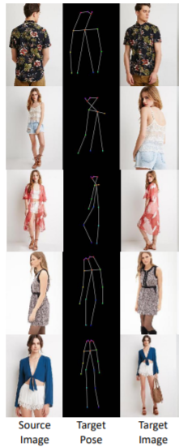
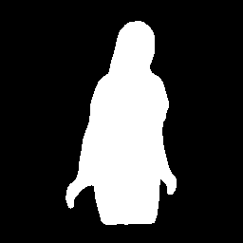
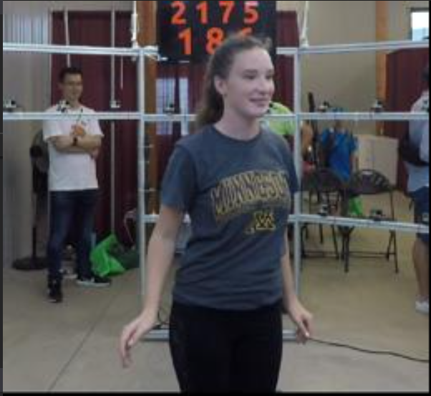
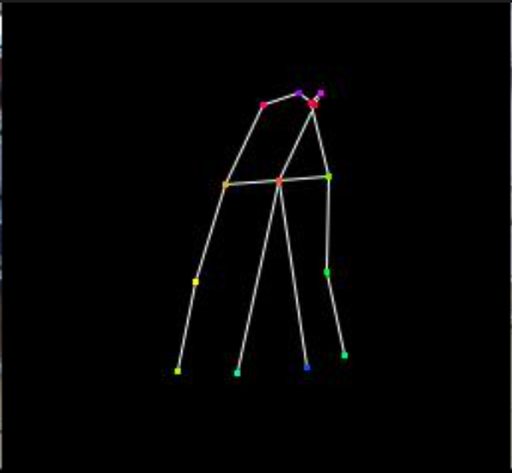
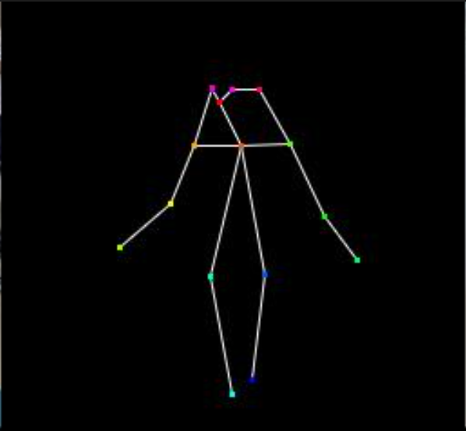
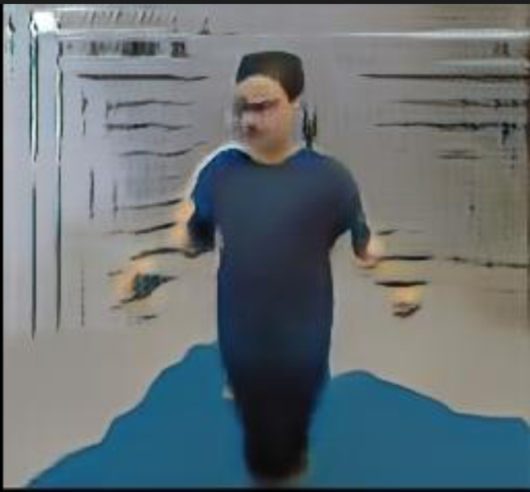
Problem definition
Inputs:
Source
Image
Mask
Keypoints
Target
Keypoints
Outputs:
Target image
Our problem is different from related work because the background is not used for evaluation on the task and we can remove it from the generated image.
Our problem is to render the person appearance from a given pose
we are given a source person image and target body pose
and our output should be a synthesized image that agrees with the taget pose and the source person
Notes:
Xianjian

Slide 3
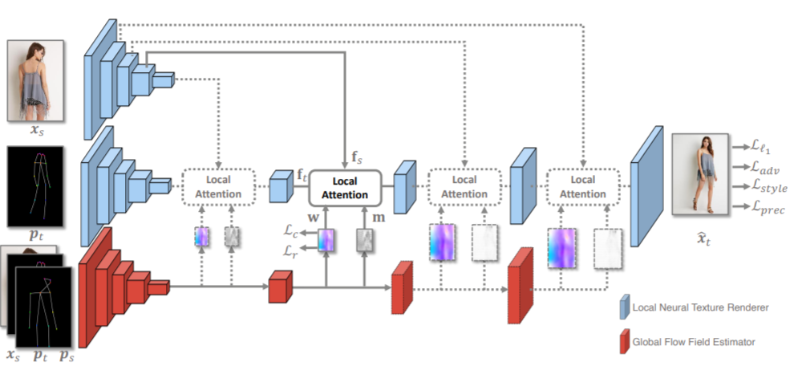
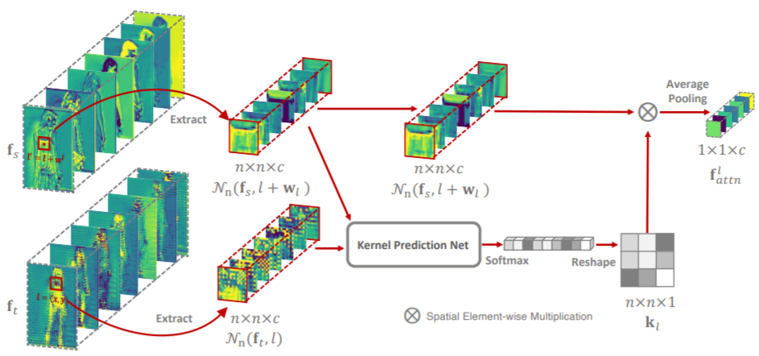
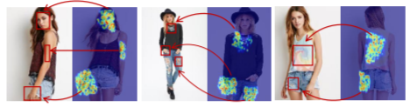
Background: Global Flow Local Attention + SilNet
Notes:
Anton
Context aware Flow field learns where the input feature (such as a face) is spatially in the input image to locate the target position of
feature in the output image, and Local attention learns the actual texture in this example what the face looks like

Slide 4
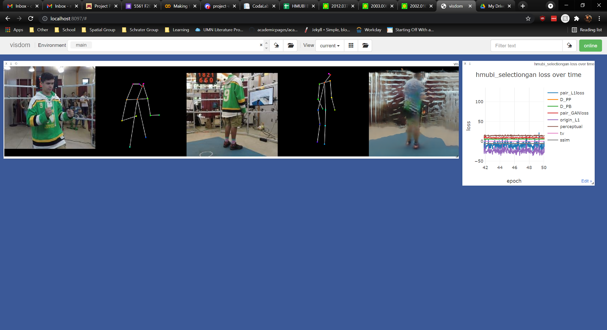
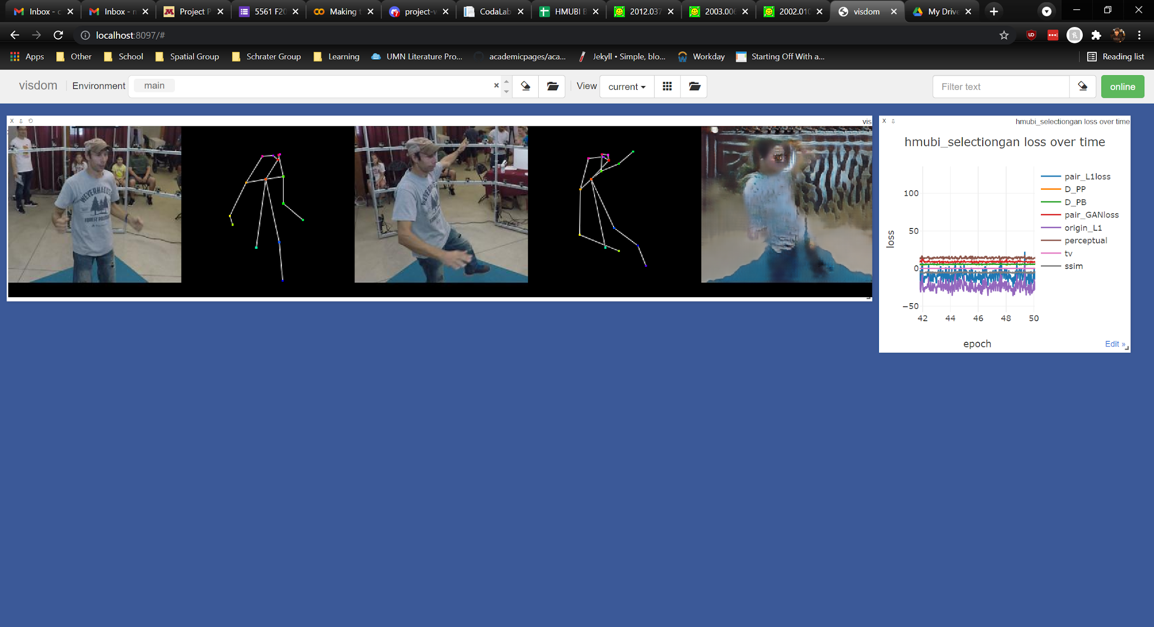
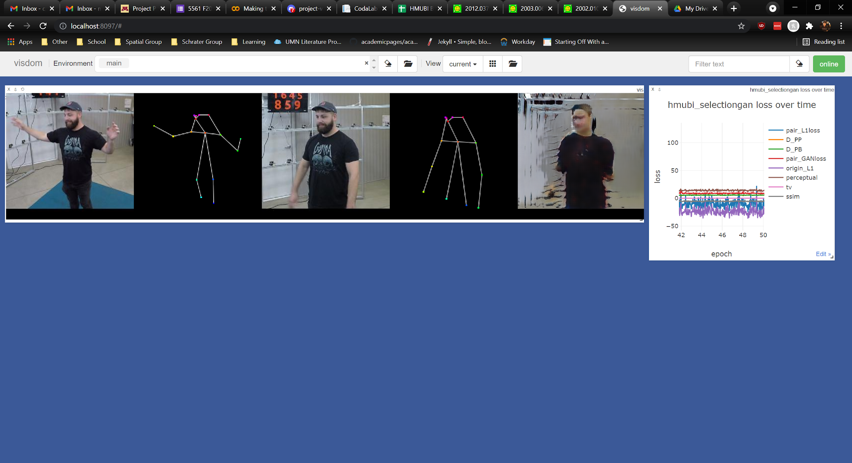
Baseline: SelectionGAN (~50k iterations)
Multi-Channel Attention Selection GANs for Guided Image-to-Image Translation https://arxiv.org/pdf/2002.01048.pdf
Notes:
Pranav

Slide 5
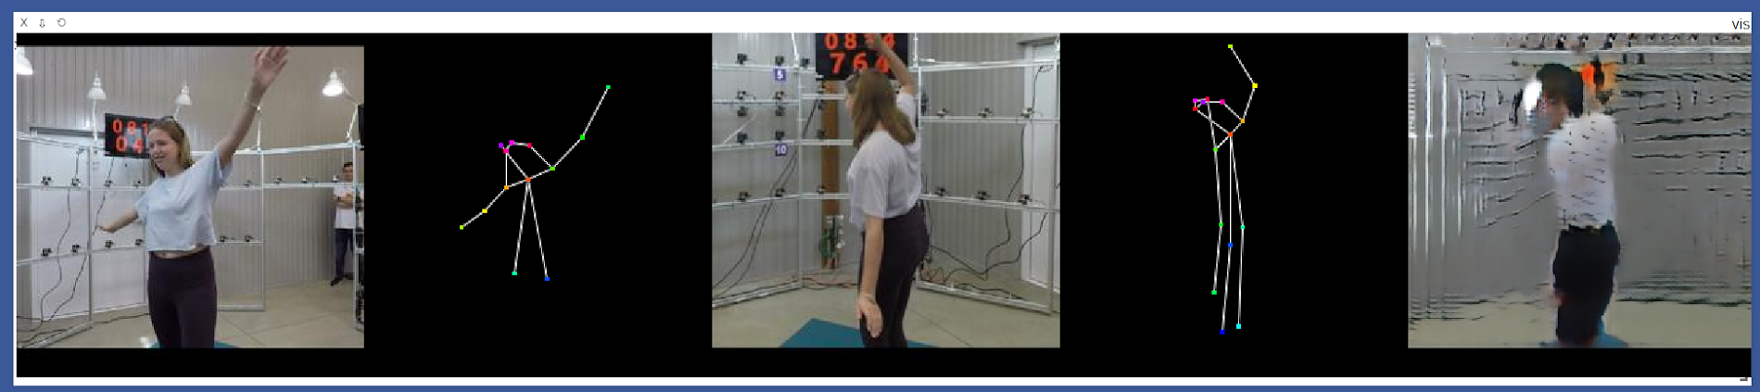
Baseline: SelectionGAN (~50k iterations)
Multi-Channel Attention Selection GANs for Guided Image-to-Image Translation https://arxiv.org/pdf/2002.01048.pdf
Limitations:
Blurry edges between clothes
Very low detail on garments
Background is very poorly rendered
Cannot distinguish between foreground and background
Arms and hair are not correctly shown in output
Notes:
Pranav

Slide 6
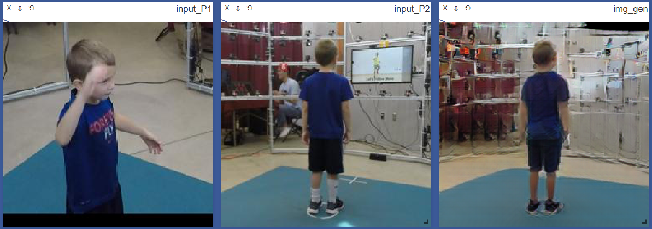
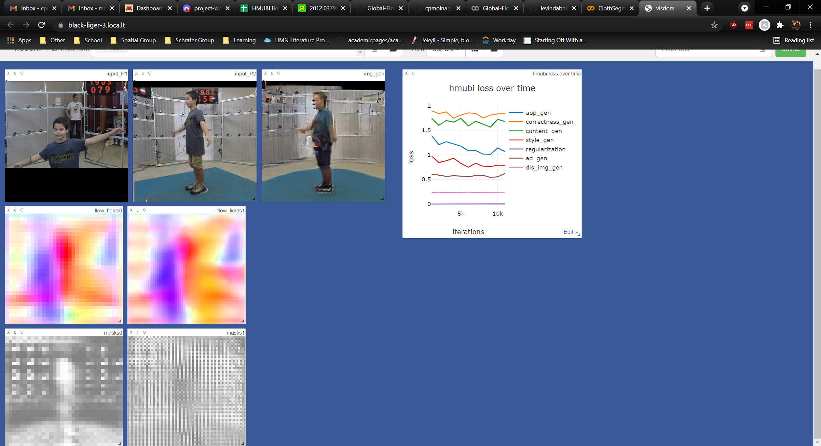
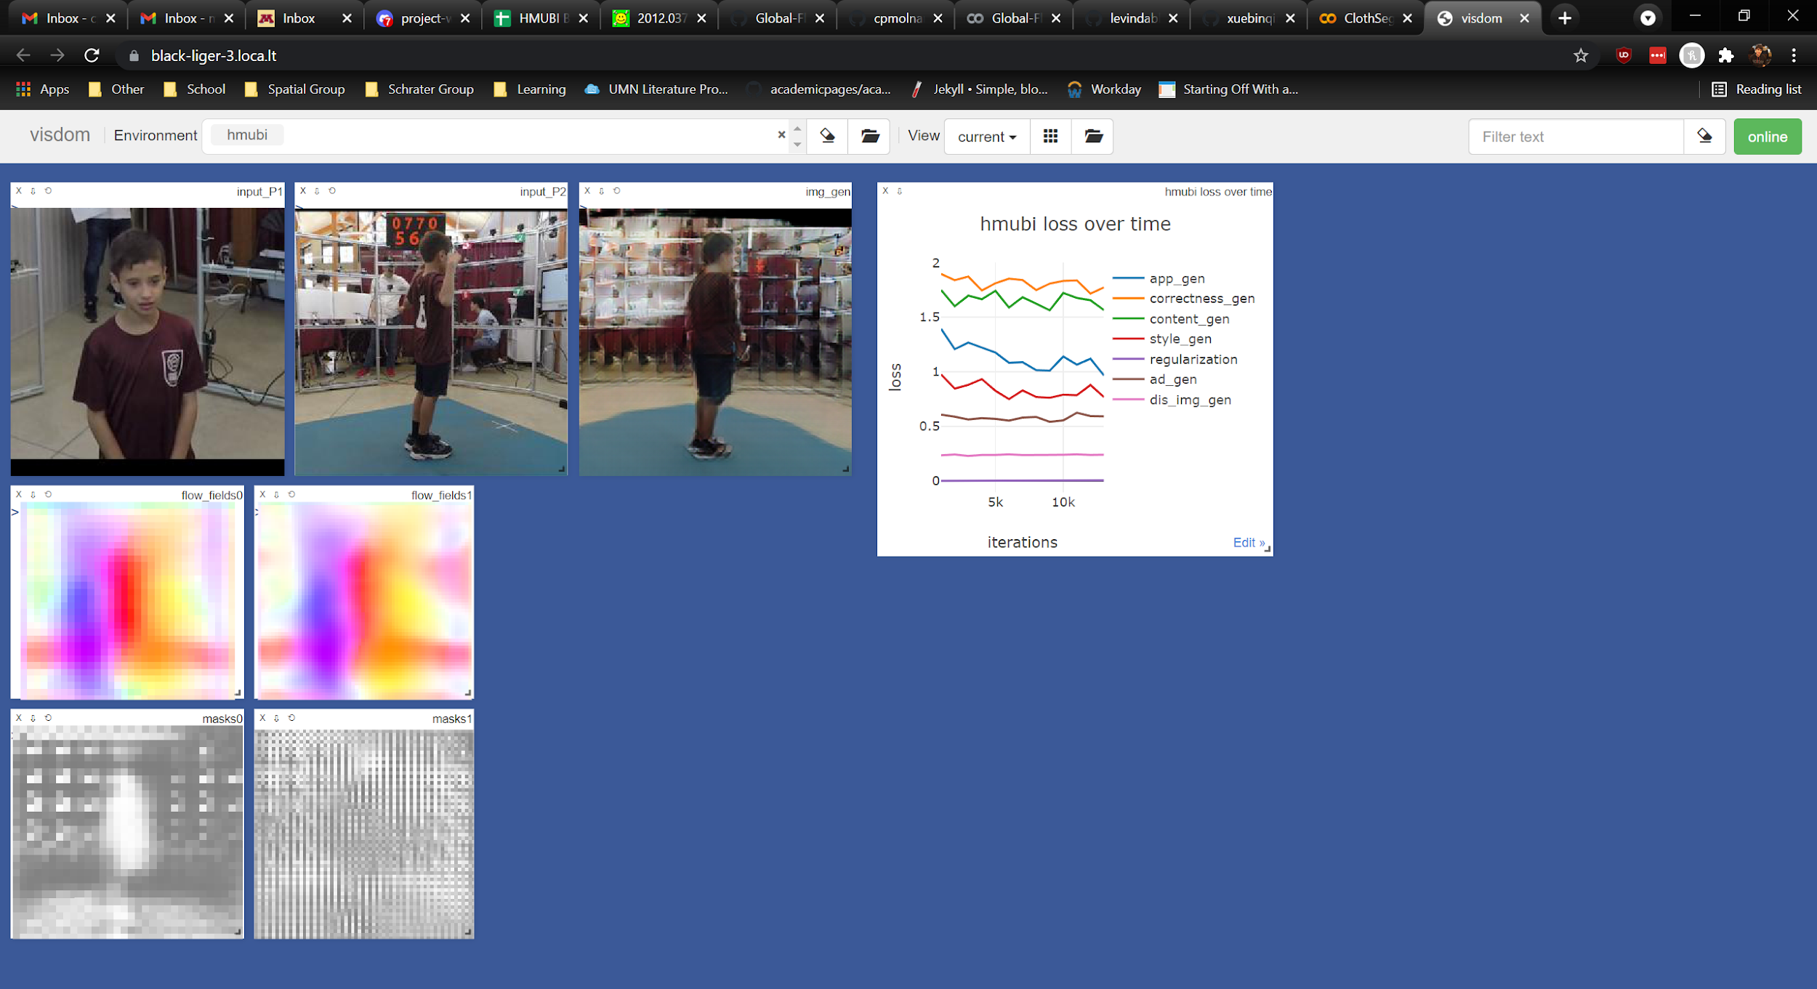
Baseline: Deep Image Spatial Transformation for Person Image Generation (~20k iterations)
Deep Image Spatial Transformation for Person Image Generation https://arxiv.org/pdf/2003.00696.pdf
Seems a lot better, but...
Limitations:
Background rendering still struggling
Blurred garment texture
Blurred garment edges
Notes:
Carl

Slide 7
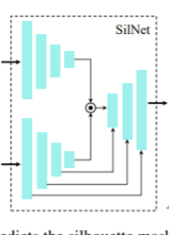

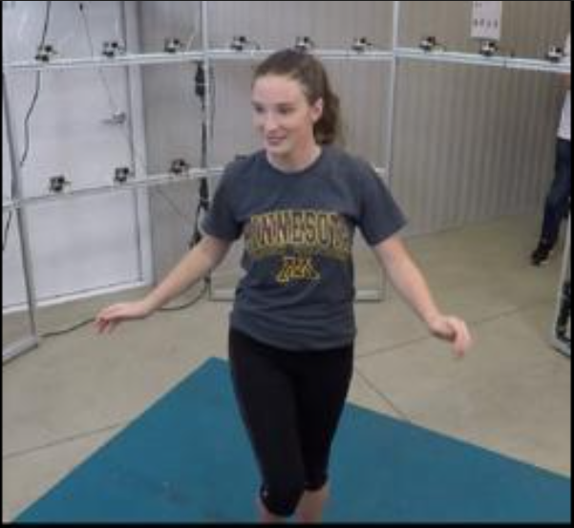
Approach: SilNet module from Pose-Guided Human Animation from a Single Image in the Wild
Idea:
Generating both foreground and background at the same time is hard.
We can separate the task of foreground and background prediction by first predicting the silhouette mask, and then building separate GANs to generate the foreground or background separately (and then overlay the results).
Note* GAN for the person should be straightforward, but the Generator network for the background will likely need positional information about the person's orientation (keypoints) as an input, as it will basically be learning a 3D model of the room, and displaying a rendering from the given viewpoint.
Source input
Overlay results
Source foreground to target foreground
Source background to target background
Pose-Guided Human Animation from a Single Image in the Wild https://arxiv.org/pdf/2012.03796.pdf
Notes:
Carl

Slide 8
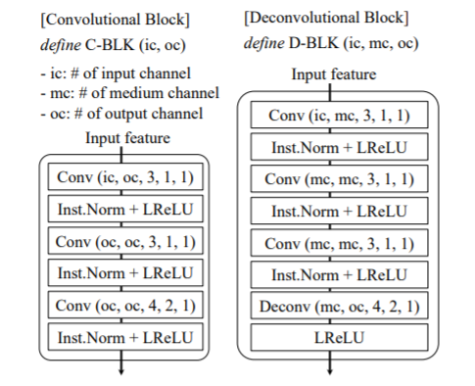
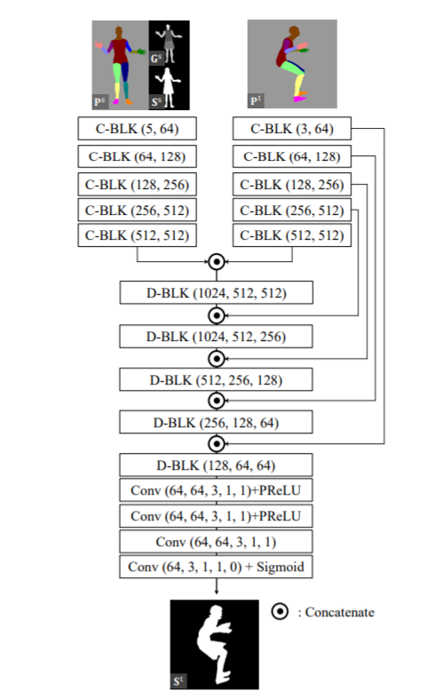
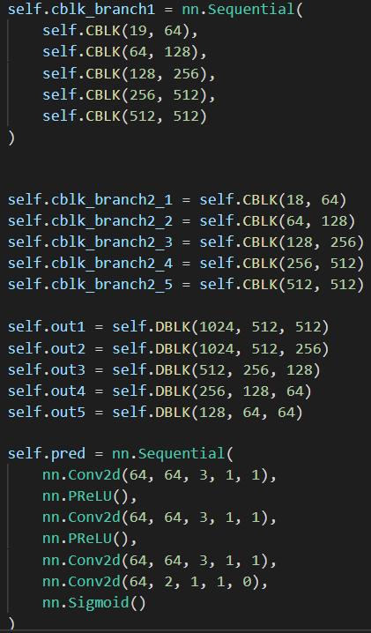
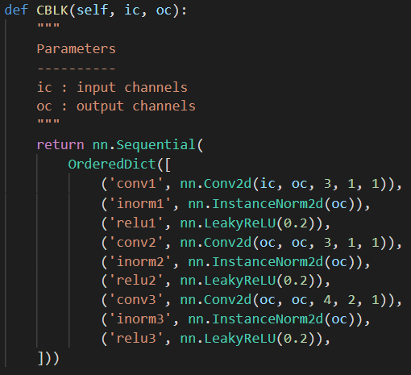
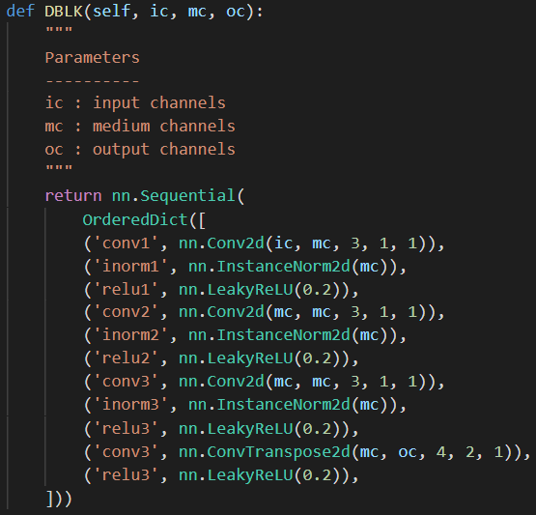
Approach: SilNet module from Pose-Guided Human Animation from a Single Image in the Wild
Pose-Guided Human Animation from a Single Image in the Wild https://arxiv.org/pdf/2012.03796.pdf
Notes:
Anton

Slide 9
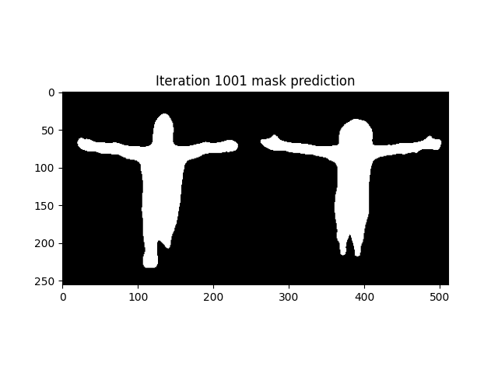
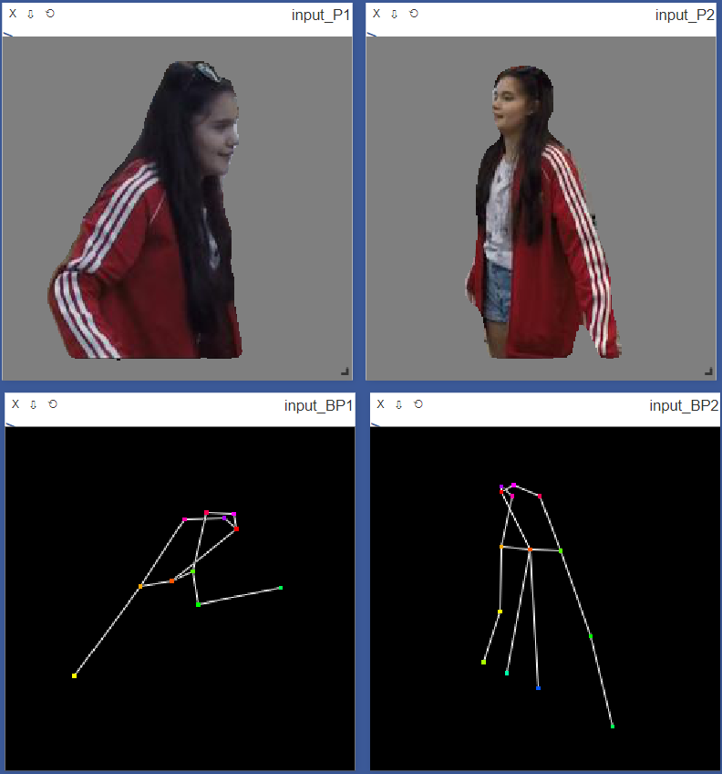
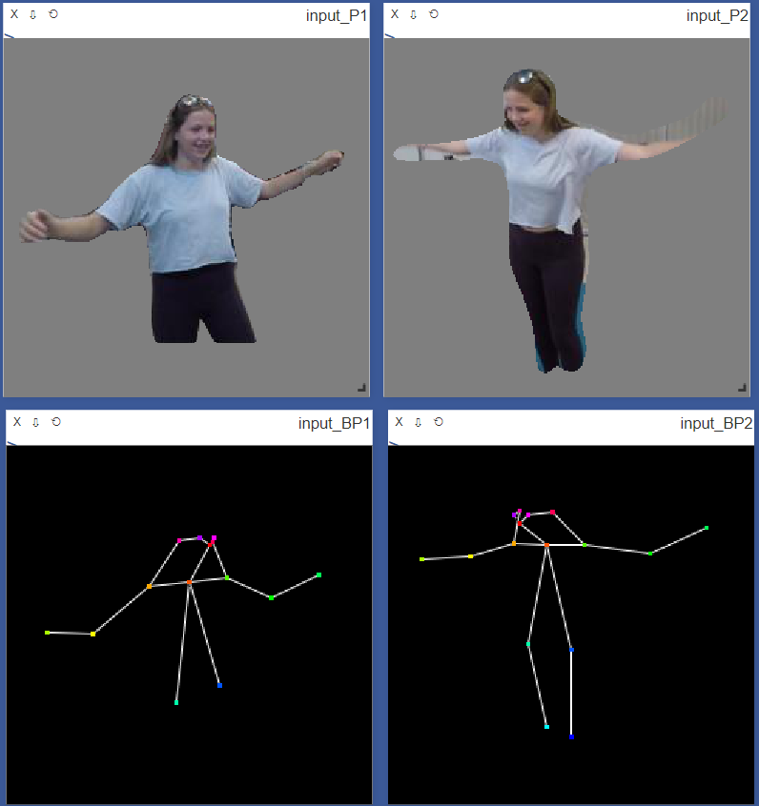
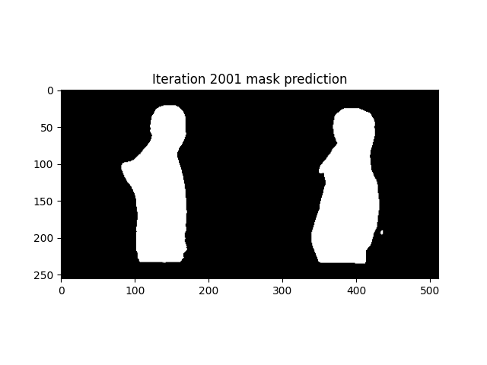
Approach: SilNet module from Pose-Guided Human Animation from a Single Image in the Wild
SilNet mask prediction
(Left: prediction, Right: ground truth)
Generated mask overlay results
Pose-Guided Human Animation from a Single Image in the Wild https://arxiv.org/pdf/2012.03796.pdf

Slide 10

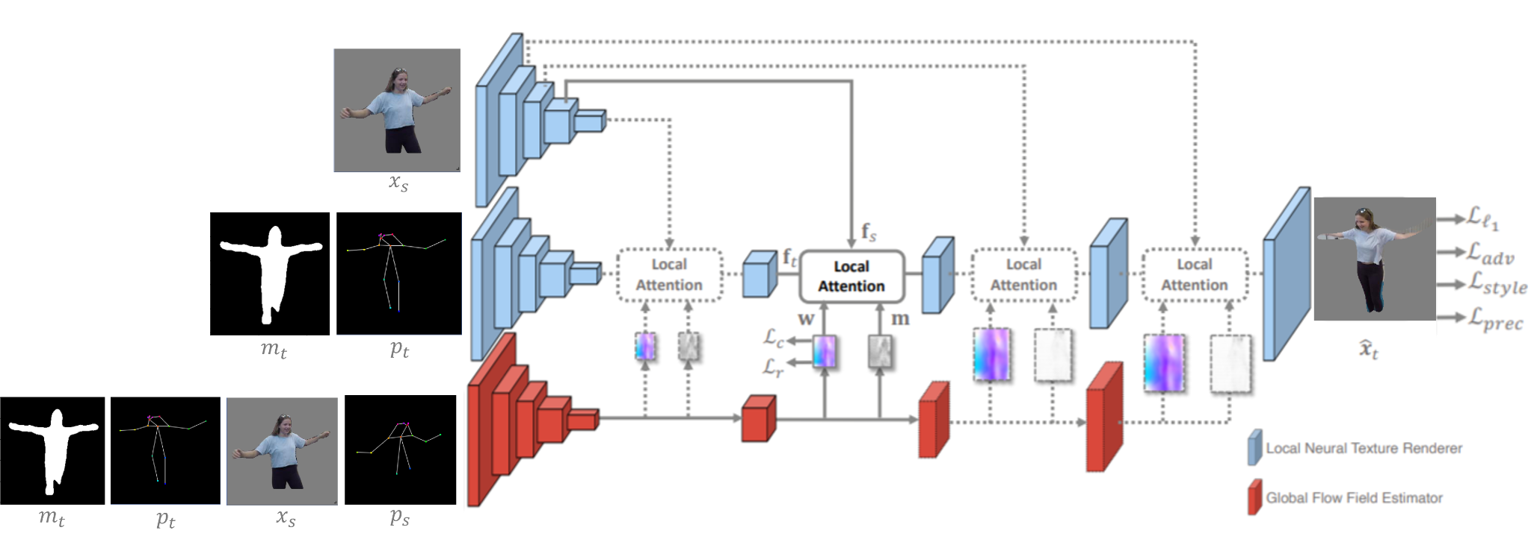

Putting it all together

Slide 11
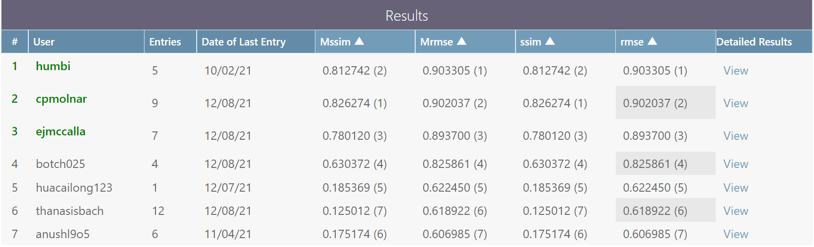
Results:
Our silnet method scores highly
Further improvements will be made by applying masks during training steps

Slide 12

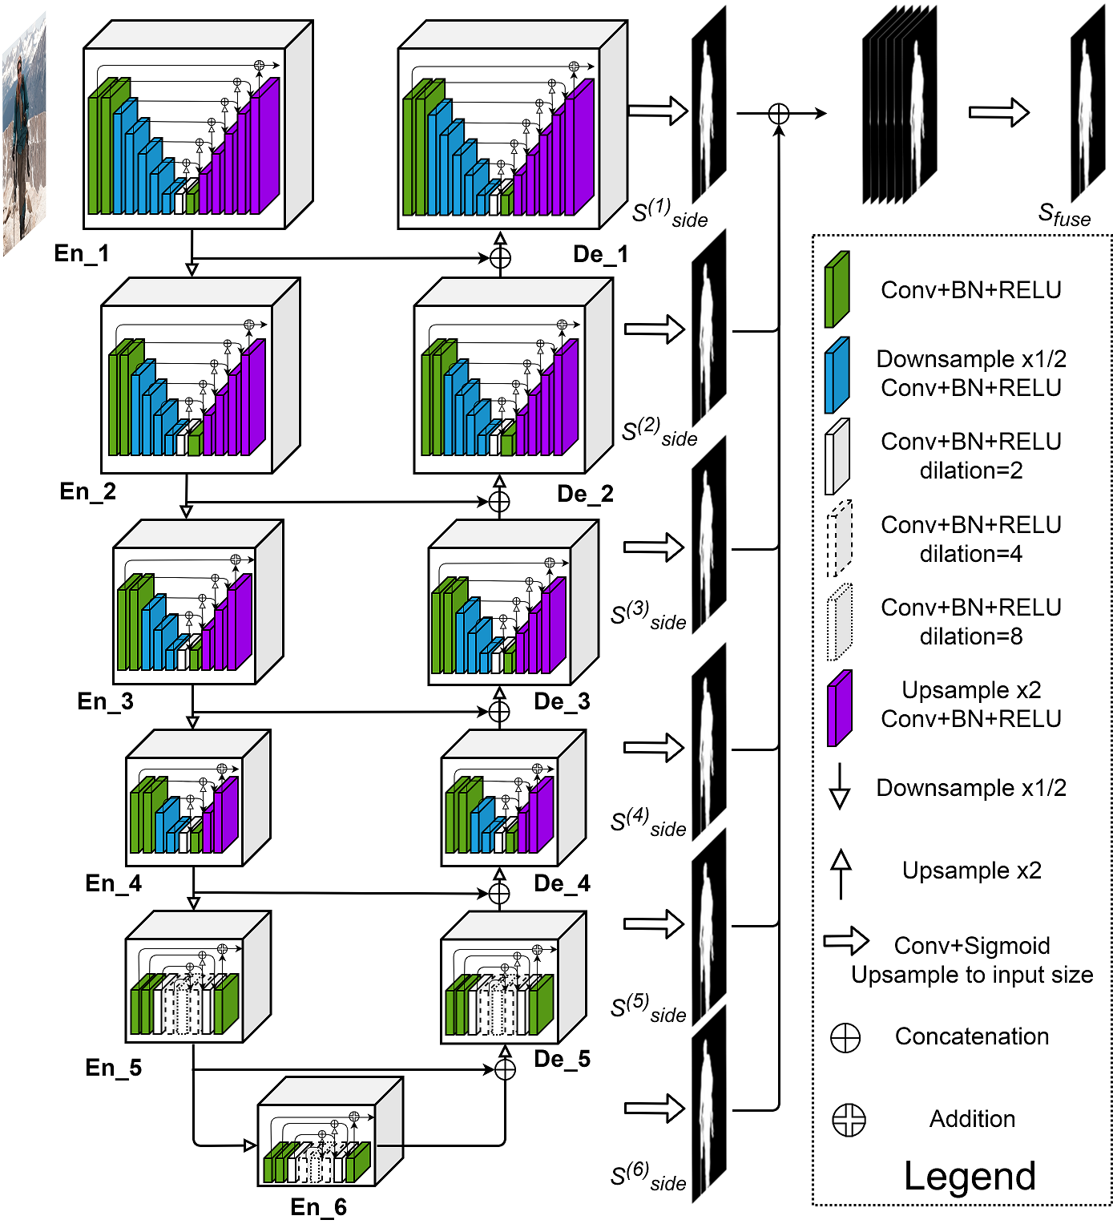
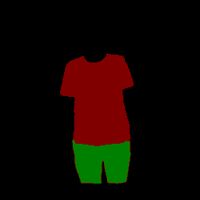
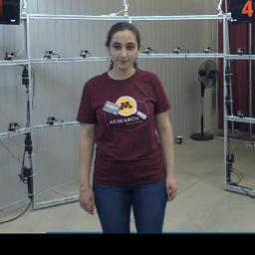
Approach: Foreground data augmentation with Garment Parsing or DensePose
Idea: By creating garment maps or pose maps, we enable embedding and warping techniques to be performed directly on the texture of the clothes.
https://github.com/levindabhi/cloth-segmentation
DensePose: Dense Human Pose Estimation In The Wild https://arxiv.org/pdf/1802.00434.pdf
Notes:
Carl

Slide 13
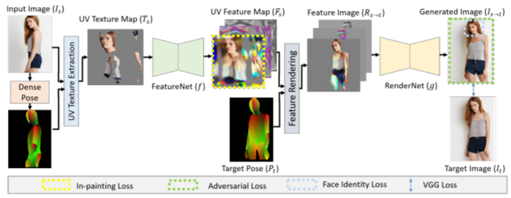
Approach: Solve texture and edge blur with UV Map-based method
Neural rerendering of humans from a single image https://arxiv.org/pdf/2101.04104.pdf
Idea: Using these maps, we can build upon UV Map-based networks as our model foundation to hopefully solve texture and edge blur problems in the foreground.
Notes:
Carl

Slide 14
Questions ?

